Slide 1
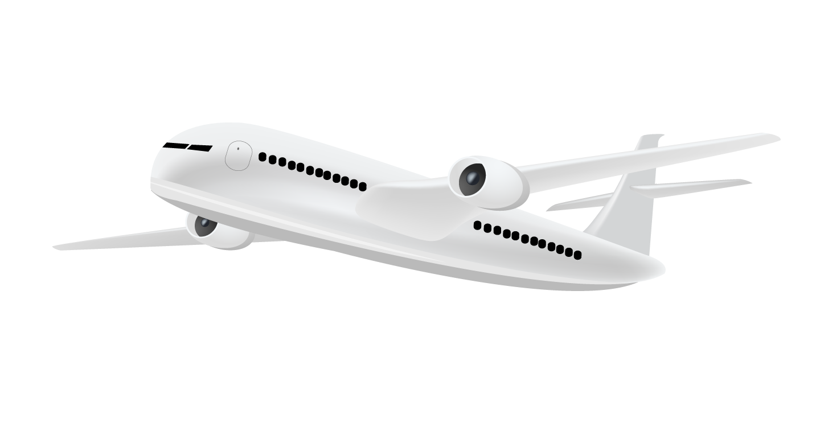
Unraveling Airline Satisfaction Insights
Presented By : Jagjeet Singh Student No : 301263211 Advisor : Billal Hasanzadah Date: 16th August 2023

Slide 2

Introduction
Imagine a traveler stepping onto an airplane. What shapes their satisfaction? Our data-driven journey reveals the answers.
In this presentation, we delve into airline customer satisfaction analysis. Using predictive analytics, we unveil the factors that impact passenger contentment.

Slide 3

Table of contents
01
02
03
04
05
06
Business Problem and Challenge
Data Collection and Preprocessing
Exploring Data Patterns and Insights
Exploring Predictive Models
Model Insights Unveiled
Recommendation and Next Steps

Slide 4
Business Problem
Enhance airline passenger satisfaction by identifying key factors amidst complex variables. Overcome data limitations, ensure accuracy, and avoid bias from customer feedback. Deliver actionable insights for operational improvement and cost savings.
Business Problem and Challenge
Data Collection and Preprocessing
Exploring Data Patterns and Insights

Slide 5

Understanding the Data
Training Data : 25 columns and 103,905 rows of data
Test Data : 25 columns and 25,977 rows of data
Attributes cover demographics, travel preferences, in-flight experiences, and satisfaction outcomes.
Business Problem and Challenge
Data Collection and Preprocessing
Exploring Data Patterns and Insights

Slide 6
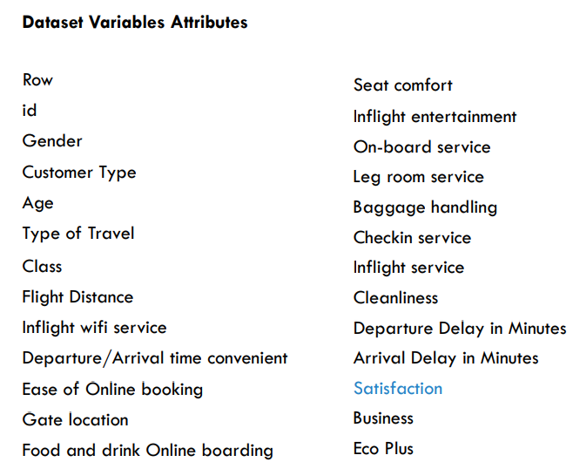
Understanding the Data
Categorical & Numeric columns
Binary outcome variable: Satisfaction as ‘satisfied’ or ‘neutral/dissatisfied’
Passenger numerical ratings (0 – 5)
Cleaned data : replaced any blanks with median for Arrival Delay in Minutes
Business Problem and Challenge
Data Collection and Preprocessing
Exploring Data Patterns and Insights

Slide 7
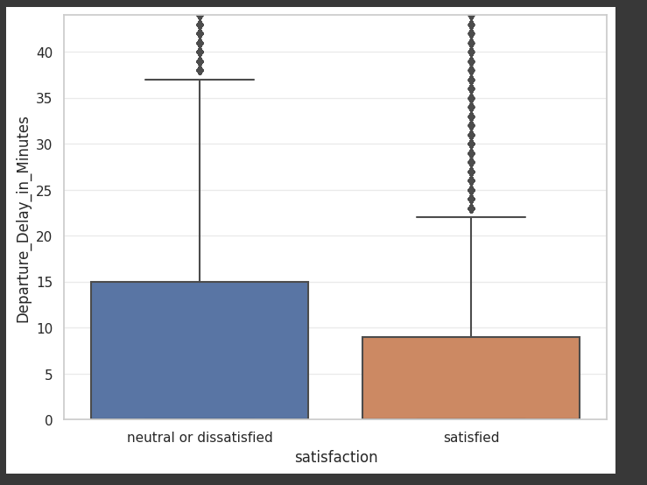
Exploring Data Patterns
Does Departure Delay affect Customer Satisfaction ?
Boxplot shows airplane departure delayal does not impact passenger satisfaction.
There is little difference in delayal minutes between those satisfied vs. not (~5-7 minutes)
Business Problem and Challenge
Data Collection and Preprocessing
Exploring Data Patterns and Insights

Slide 8
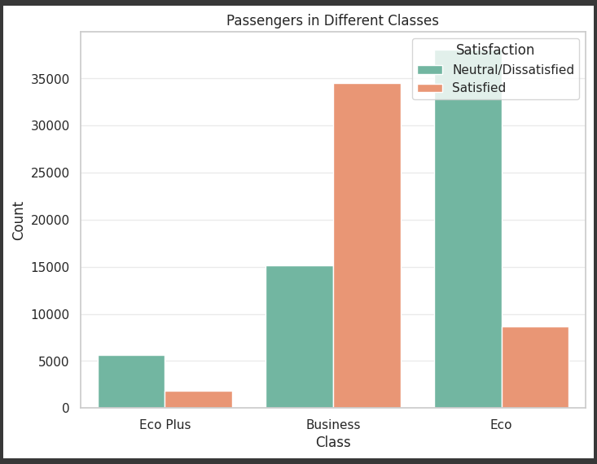
Exploring Data Patterns
Does Passenger Class play an important role?
As expected, satisfied passengers were more likely to fall in the business class (approx.75%) vs. ‘neutral or dissatisfied’ who mostly flew Economy class (~60%).
Business Problem and Challenge
Data Collection and Preprocessing
Exploring Data Patterns and Insights

Slide 9
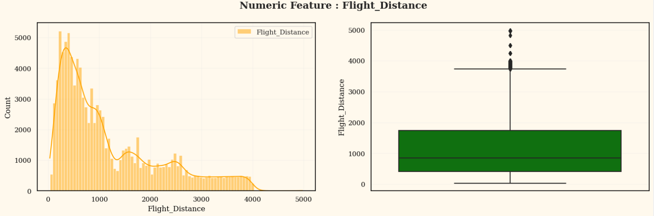
Exploring Data Insights
Flight distance data is left-skewed, not a perfect normal distribution.
Retaining outliers ensures comprehensive analysis and real-world representation.
Business Problem and Challenge
Data Collection and Preprocessing
Exploring Data Patterns and Insights

Slide 10
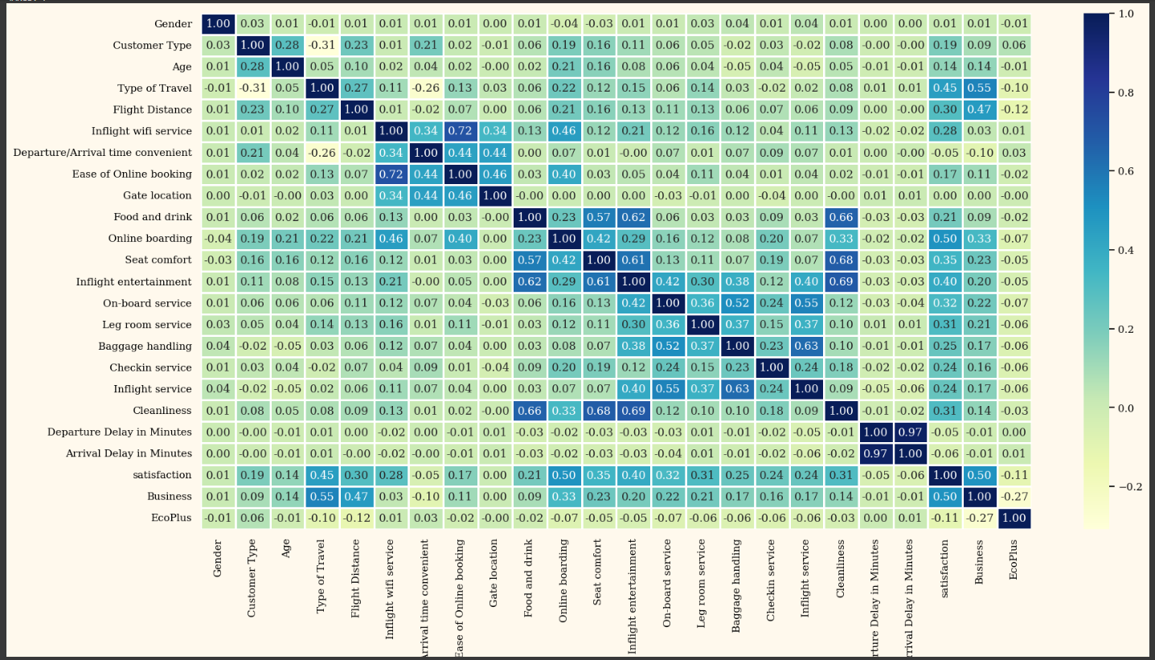
Correlation Heatmap
Selected attributes with higher correlation to satisfaction, which was mostly in-flight passenger experience
Business Problem and Challenge
Data Collection and Preprocessing
Exploring Data Patterns and Insights

Slide 11


Predictive Techniques Used
Logistic Regression
Naïve Bayes
KNN
CART
Random Forest
Exploring Predictive Models
Recommendation and Next Steps
Model Insights Unveiled

Slide 12
Models Comparison
Choice of Metric: Accuracy
Accuracy is widely used to evaluate classification models.
Aligns with predicting customer satisfaction accurately.
Model | Accuracy (%)
Naive Bayes | 86.48
K-Nearest Neighbors | 93.64
CART (Decision Trees) | 95.00
Random Forest | 96.30
Logistic Regression | 82.97
Logistic Regression – Forward | 84.59
Logistic Regression – Backward | 86.80
Exploring Predictive Models
Recommendation and Next Steps
Model Insights Unveiled

Slide 13
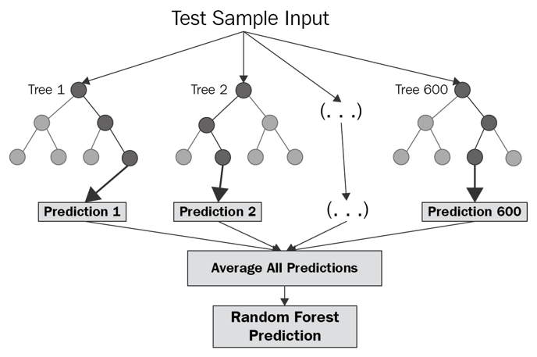
Model Insights
Random Forest Model
Ensemble Learning Technique: Random Forest is an advanced ensemble learning method in machine learning.
Overfitting Mitigation: Random Forest mitigates overfitting by blending individual tree predictions.
Reliable Predictions: By minimizing individual tree weaknesses, Random Forest ensures reliable predictions.
Exploring Predictive Models
Recommendation and Next Steps
Model Insights Unveiled

Slide 14

96% Accuracy
Random Forest Model Accuracy for the test data.
Exploring Predictive Models
Recommendation and Next Steps
Model Insights Unveiled
Notes:
Our Random Forest model is delivering impressive accuracy on the test data, helping us make accurate predictions.False Positive Rate (FPR):What is it? False Positive Rate is when the model wrongly predicts satisfaction (satisfied) when it's not actually the case.Calculation: (Predicted Satisfied / (Predicted Satisfied + Predicted Not Satisfied)) = 10737 / (10737 + 294) = 0.973False Negative Rate (FNR):What is it? False Negative Rate is when the model wrongly predicts dissatisfaction (not satisfied) when it's not true.Calculation: (Predicted Not Satisfied / (Predicted Not Satisfied + Predicted Satisfied)) = 294 / (294 + 10737) = 0.026Our Random Forest model is showcasing high accuracy, contributing to dependable predictions. Additionally, the calculated false positive rate and false negative rate provide insights into the model's performance when dealing with different satisfaction outcomes. This enables us to refine our approach and continue enhancing passenger satisfaction.

Slide 15
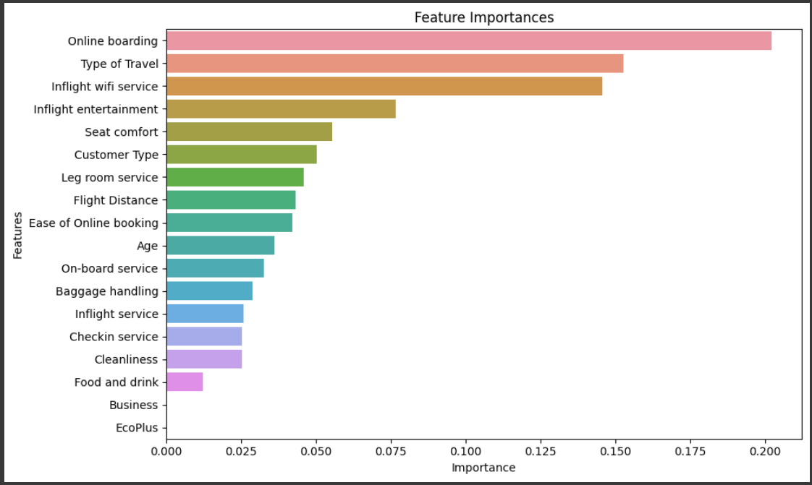
Model Insights
Leveraged GridSearchCV to identify optimal hyperparameters for Random Forest.
Key parameters: Number of Trees (200), Maximum Depth (Unrestricted), Minimum Samples per Leaf (2), Minimum Samples per Split (10).
Hierarchical feature importance list guides strategic decisions and service tailoring.
Exploring Predictive Models
Recommendation and Next Steps
Model Insights Unveiled
Notes:
Ensemble Learning Technique:What is it? Random Forest is a smart way to combine the insights of many individual models into one powerful prediction.Preventing Overfitting:Why it matters? Overfitting can lead to wrong predictions. Random Forest tackles this by combining many predictions, preventing the model from getting too attached to any one pattern.Dependable Predictions:How it works: By bringing together different model views, Random Forest patches up individual weak spots, delivering predictions that you can trust.With the Random Forest technique, we're equipped to make predictions that are robust, reliable, and ready to power our understanding of passenger satisfaction.

Slide 16

Actionable Insights
Prioritize seamless inflight Wi-Fi and enrich entertainment options for enhanced customer satisfaction.
Enhance online booking convenience and streamline boarding processes to elevate passenger experience.
Investigate and rectify the factors that contribute to the dissatisfaction of 26% of passengers with their seats.
Leverage insights from the 69% business traveler segment to tailor offerings and provide exclusive benefits.
Exploring Predictive Models
Recommendation and Next Steps
Model Insights Unveiled
Notes:
Seamless Inflight Wi-Fi and Enriched Entertainment:Why it matters: Prioritize the development of seamless inflight Wi-Fi services and expand entertainment options. This ensures passengers remain engaged and connected throughout their journey.2. Streamlined Online Booking and Boarding:Why it matters: Enhance the convenience of online booking procedures and streamline boarding processes. By reducing hassles, we contribute to a smoother and more pleasant passenger experience.3. Addressing Seat Dissatisfaction:Why it matters: Investigate and resolve the root causes of dissatisfaction among 26% of passengers with their seats. Tailoring seating options and comfort can significantly impact overall contentment.4. Tailoring to Business Traveler Insights:Why it matters: Leverage the insights gathered from the 69% business traveler segment. Customizing offerings and providing exclusive benefits can enhance loyalty and satisfaction within this valuable segment.These strategic recommendations hold the potential to redefine passenger satisfaction and position our airline as a leader in delivering exceptional journeys. Together, let's embark on a journey to elevate the flying experience to new heights.

Slide 17
Further Analysis
Location of airport boarding could also shed light on customer satisfaction. City location could have a bigger impact than the current columns.
Carry out an independent study specifically focused on seat comfort, considering factors beyond just seat materials. This study should examine how seat comfort directly influences passenger satisfaction.
Around half of business class travelers are loyal, while this drops by almost 10% for economy class passengers. This highlights the need to increase loyalty in the economy class. Further investigation into enhancing this loyalty is recommended..
Exploring Predictive Models
Recommendation and Next Steps
Model Insights Unveiled

Slide 18
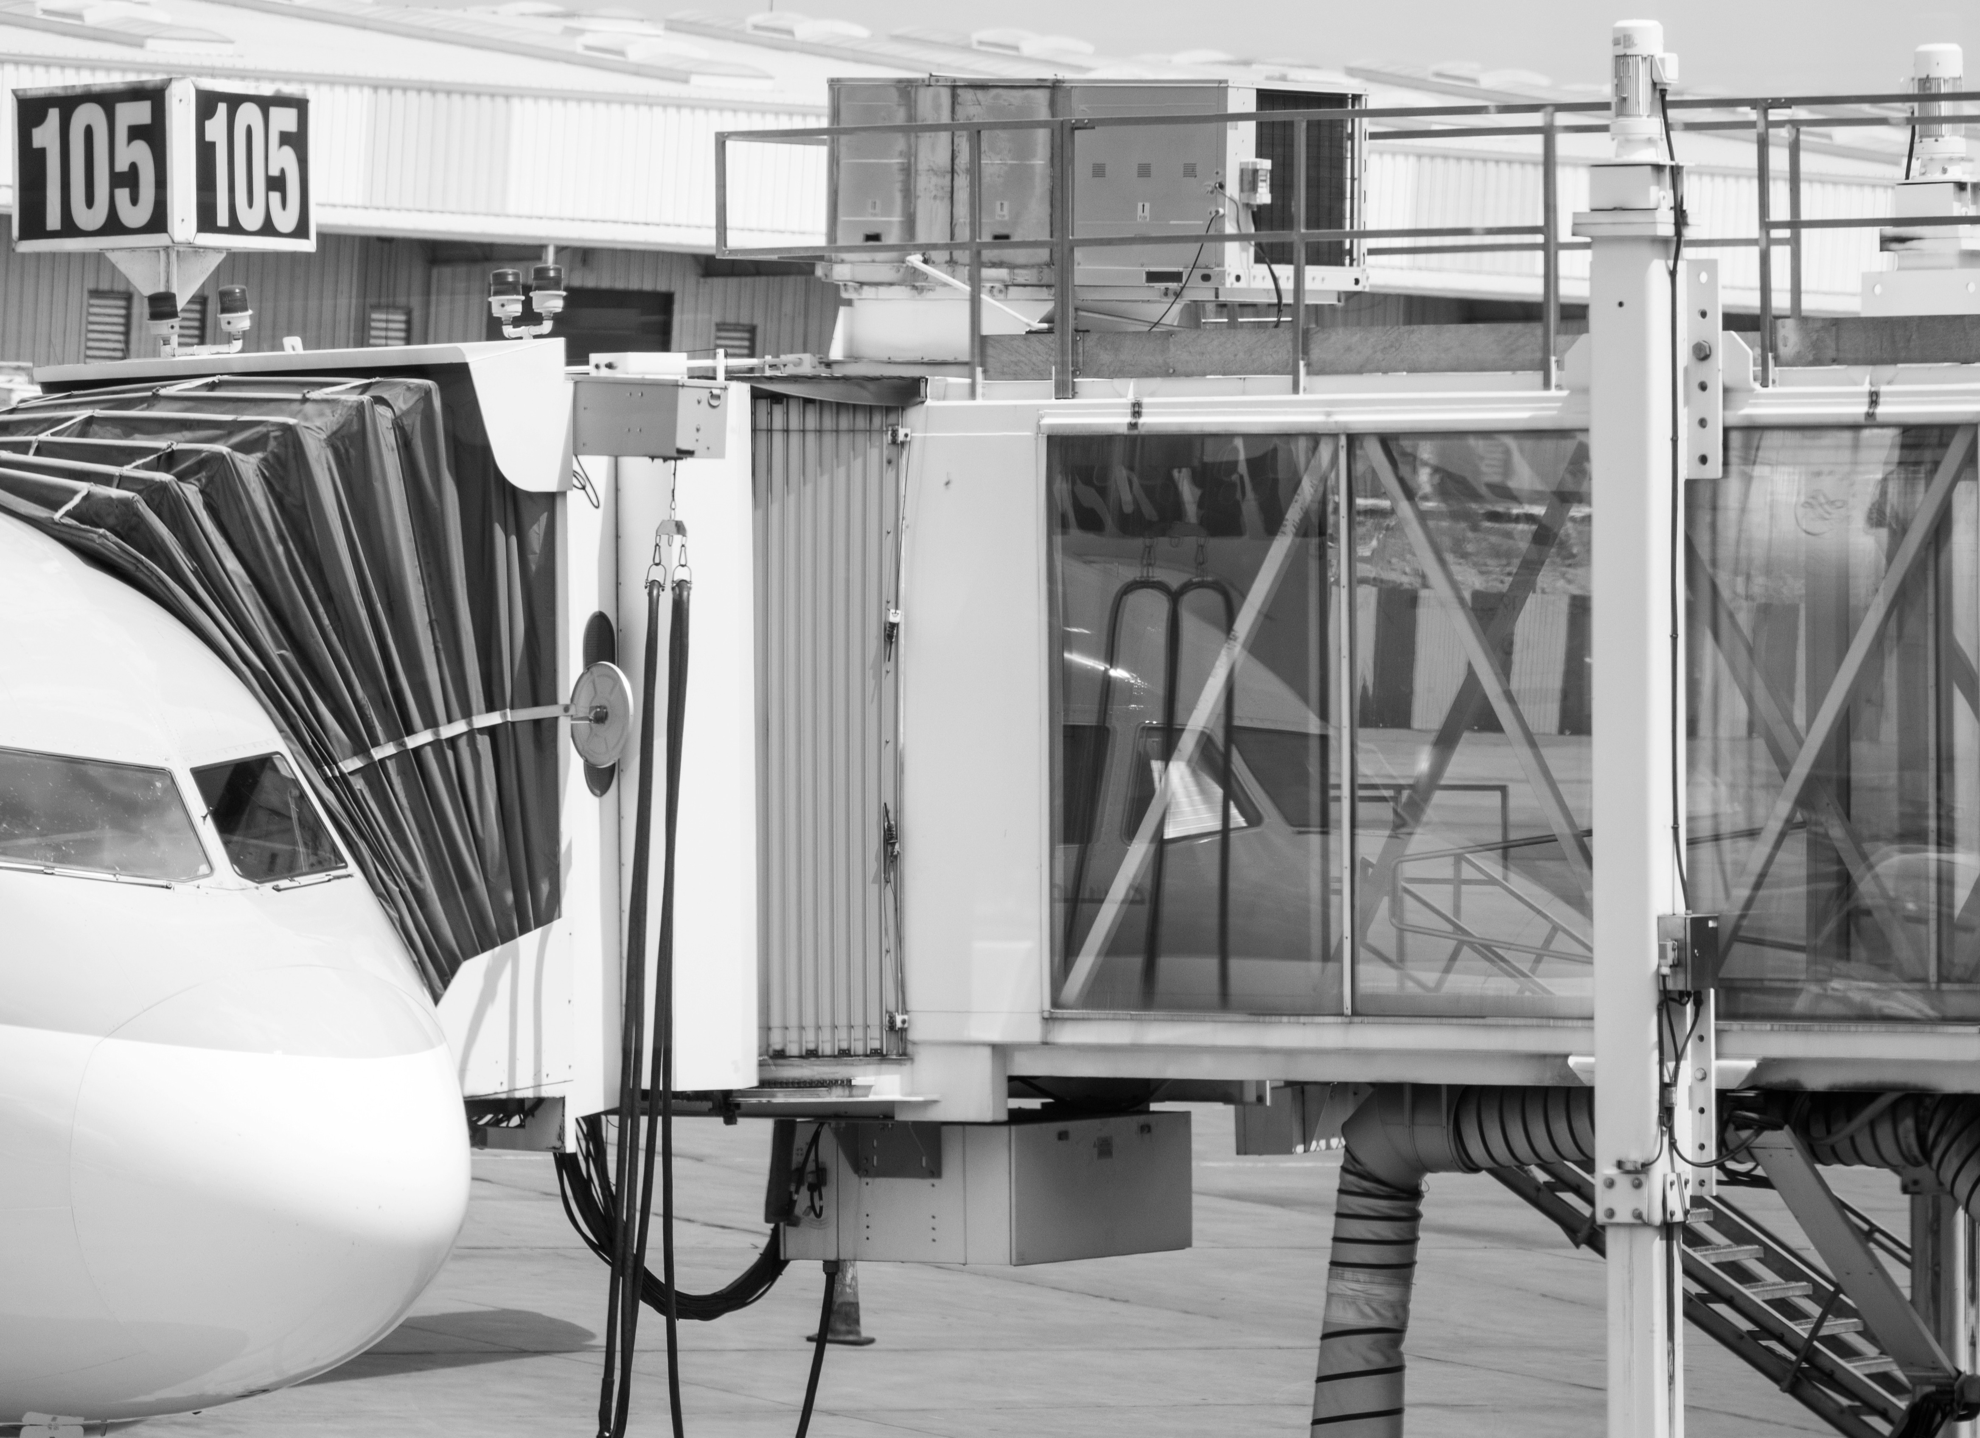
Any Questions ?

